Slide 1
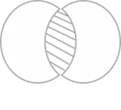

CareHub
Development of an Application for Daily
Management and Support for Parkinson's Patients
Capstone Project Phase B
24-2-D-21
Presented by:
Omer Sommerstein
Aviram Fishman
Supervisor:
Dr Julia Sheidin
Notes:
להדגיש שאנחנו שלב ב' !!!

Slide 2


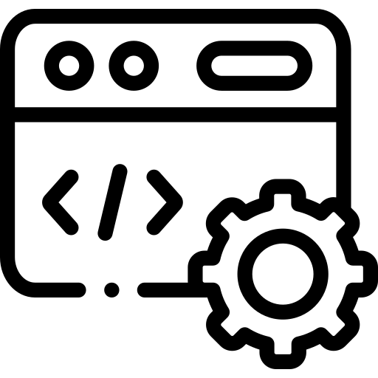

Introduction
Parkinson’s Disease Overview | Disease Management
01
Agenda
02
The Problem
03
Development
CareHub Screens | System Architecture
CareHub in Action
Achievement | Video
04

Slide 3


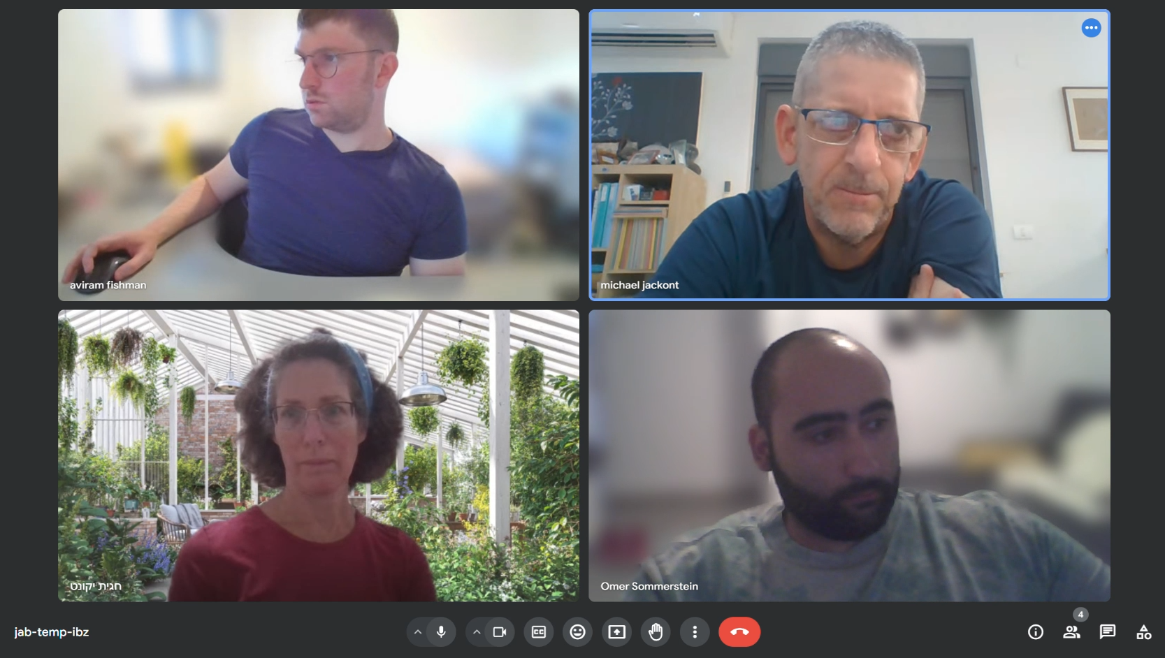

This flagship project at Brauda College focuses on developing innovative engineering solutions for individuals with disabilities.
At its core, the project aims to improve the quality of life for those facing physical challenges.
Michael Jackont, 57-year-old, a person living with Parkinson’s disease (PD), is an integral partner throughout the entire process, providing valuable insights and feedback to ensure the solutions meet real-world needs.
Notes:
להדגיש שמיכאל נמצא בקהל !!!

Slide 4
Introduction
Parkinson’s Disease Overview
01
1
2
3
What it is Parkinson?
Affecting on?
Parkinson Patient are always shaking?
Progressive neurodegenerative disorder.
The second most common neurodegenerative disorder.
Cognition.
Motor Skills like tremors, muscle stiffness, and slowed movement.
No, there is two state:
"ON" - where they can perform daily activities.
"OFF" - where their symptoms appeared.
Notes:
“ON” - perform their daily activities like driving, cooking, and walking according to their lifestyle.
“OFF” - feeling stuck can't do the ordinary daily activities

Slide 5
Parkinson's Disease Challenges
01
Although there is no cure for Parkinson's disease, there are ways to manage its symptoms and improve the quality of life for patients.
One of the approaches is adopting a comprehensive management strategy that combines medical, lifestyle, and supportive interventions tailored to the individual's needs.
Notes:
Chronic disease
Incurable
There are ways to live with it (management)

Slide 6

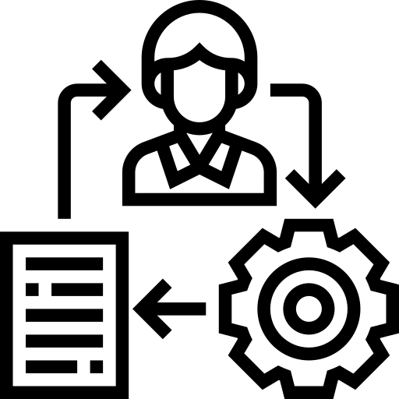

Parkinson's Disease Management
01
Although there is no cure for Parkinson's disease, there are ways to manage its symptoms and improve the quality of life for patients.
Consistent tracking
Structured daily routines
Proper Management
Symptoms
Medicines
Nutrition
Physical Activities
Help to identify patterns that improve symptom control.
Improves:
Motor symptoms
Non-motor symptoms such as mood, sleep, and cognitive function
Notes:
Researchers emphasize the critical role of managing daily routines for Parkinson's Disease (PD) patients. Studies show that:
Consistent tracking of medication, nutrition, and physical activity can significantly extend "ON" periods.
Structured daily routines help identify patterns that improve symptom control.
Active monitoring of symptoms allows for early interventions and adjustments.
Proper management improves not only motor symptoms but also non-motor symptoms such as mood, sleep, and cognitive function.
By efficiently managing their daily activities, PD patients can experience better outcomes ,more balanced lifestyle and extend "ON" periods.

Slide 7
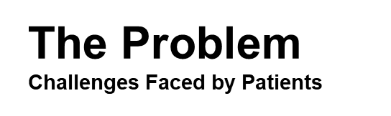
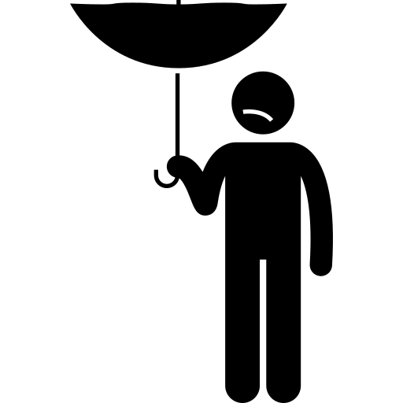
02
Manual Tracking
Patients rely heavily on manually tracking their medication, nutrition, and physical activity to manage their "ON" state and “OFF” state.
Cognitive Issues
A Parkinson's patient experiences cognitive issues that impact memory.
Ineffective Treatment
Traditional methods
Traditional methods, like Excel or Google Sheets, lead to errors due to cognitive challenges such as memory loss in some cases.
Insights
Caregiver derives insights from the Parkinson's patient documentation to create a personalized treatment plan.

Slide 8
Development
Work Process With Michael
03
Demonstrated the developed CareHub system to Michael.
Received positive feedback, as reflected in the SUS.
Identified the need for a user-friendly app tailored to Michael’s Parkinson’s condition.
Met with Michael’s nutritionist to understand the impact of diet on Parkinson’s and bowel movements.
Kick-Off Meeting
System Presentation
Nutritionist Interview
Sports Hall Visit (Kadori)
Prototype Review
Observed Michael and other patients playing table tennis.
Reviewed Parkinson patient, physiotherapist, and coaches to refine app requirements.
Presented initial CareHub screens to Michael, ensuring they met his needs for data entry and usability.

Slide 9
Development
Requirements
03
Functional Requirements:
Logging important data:
Symptom
Medicine
Nutrition
Training
User authentication
Data visualization
Non-Functional Requirements
Intuitive interface
Minimal scrolling
User-centric design
Data security
Easy maintenance

Slide 10


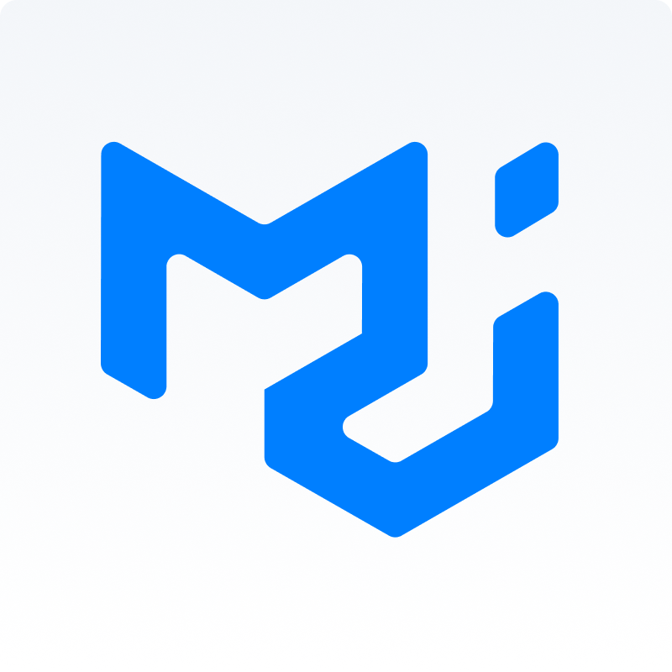

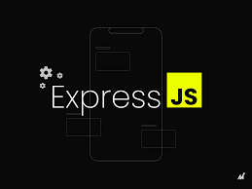


Development System Architecture
03
The application built using the MERN stack.
The system is a web-based solution that is accessible from multiple devices.
MUI
Front-End
Back-End
Database
Deployment

Slide 11
04
CareHub In Action
Achievement
Simplifies Health Tracking
Allowing Michael to log symptoms, medications, nutrition, and physical training effortlessly. It replaces manual record-keeping with accurate digital tracking, helping patients identify patterns and optimize treatment.
Simple and Intuitive Interface
Designed to minimize cognitive and motor challenges for Michael. With large buttons, minimal scrolling, and cross-platform accessibility, users can easily log data and track their health from any device.
User Satisfaction CareHub received a System Usability Scale (SUS) score of 80/100, highlighting its ease of use and accessibility.
Notes:
אולי בגלל שמיכאל יהיה במצגת, אז במקום Parkinson patient עדיף פשוט לכתוב מיכאל?

Slide 12

04
CareHub In Action
Video

Slide 13
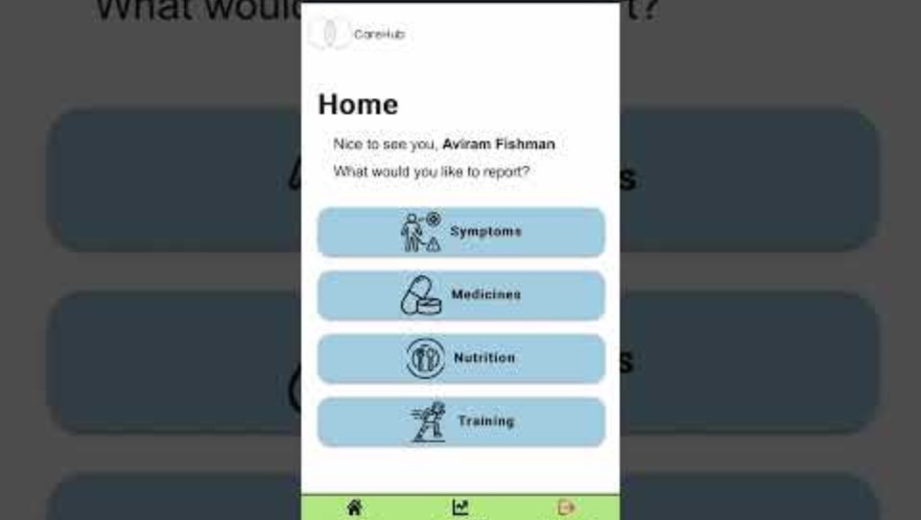
04
CareHub In Action
Video
CareHub in Action(להוסיף סרטון)

Slide 14
04
CareHub In Action
Challenges
UI Optimization for CareHub
Challenge: Maintaining an accessible, clear, and responsive interface across various devices while considering the motor and cognitive challenges of Parkinson’s patients. Insights: Implemented a dynamic layout that adjusts element sizes, button spacing, and text visibility based on screen resolution. Ensured ease of navigation across different devices while preserving the intended design.
Cross-Device Compatibility
Challenge: Making CareHub accessible on both Android and iOS devices, along with PC’s. Insights: Developed a web-based system, allowing users to access CareHub from any device, ensuring a seamless experience across mobile, tablet, and desktop.
Displaying Data in the View Data Page
Challenge: Displaying all logged events efficiently while managing database response time. Insights: Introduced a loading spinner to maintain user experience while data is retrieved. Optimized data fetching techniques to reduce wait times and enhance responsiveness.

Slide 15
04
CareHub In Action
Security Measures
Secure password hashing using bcrypt
Express.js middleware for request validation
CORS (Cross-Origin Resource Sharing) configuration
JSON Web Tokens (JWT) for secure session management
User data isolation (each user can only access their own data)
Environment variables (.env file) for sensitive configuration data
Email and password validation on both frontend and backend (no case-sensitive for Email)
Notes:
להציג בתור רעיון כללי ולהציג נקודה אחת או שתיים שלהתייחס אליהם

Slide 16

Future Work
We provided the infrastructure for this project, and there are follow-up projects that will introduce their Phase A after ours. The sky is the limit!

Slide 17
Q&A
Feel free to ask any question!
Thank You 😉

